Slide 1

Final Group Project: Proof-of-Concept Data Analysis
Presented by Group 3
Dec 4th, 2024

Slide 2
Project Summary
Objecttive:
Demonstrate our data analysis capabilities
Scope:
Data analysis and visualization.
Results and insights.
Tools Used:
Programming: Python
Cloud: Amazon RDS
Database: MySQL
Visualization: PowerBI, Excel.
Project proposal.
Data acquisition and storage.

Slide 3
Team overview
Project Manager:
Shamili Kothakonda: Manages deliverables, makes project proposal, segment tasks for everyone.
Business Analyst:
Harsha Vardhani Mundeshwar: Explore the data and help project manager build the project proposal.
Mahak Kansal: Explore the data and work with project manager to build the project proposal.
Developer:
Ngoc Quang Minh Nguyen: Acquire data, clean data and put data into cloud.
Data Analyst:
Arjun Pillai: Develop an understanding of the dataset
Darshana Dhandapani: Create data visualizations to derive the insights.

Slide 4

Project Proposal

Slide 5
Project overview & objectives
Analyze customer shopping behaviour
Support strategic decision-making
Uncover key patterns and trends, enhance customer experience

Slide 6
Scope of the Project:
Customer Demographics Analysis
Project and Category Analysis
Shopping Mall Performance
Revenue Trends
Payment Method Analysis
Customer Value Segmentation

Slide 7
Dataset Overview:
Variable | Type | Description
Invoice_no | String | Invoice identifier
Customer_id | String | Unique identifier for each customer
Gender | Nominal (“Male”, “Female”) | Customer gender
Age | Ratio | Age of the customer
Category | String | Product category purchased
Quantity | Ratio | Quantity of items purchased
Price | Interval | Total price of the purchase
Payment_method | Enum (“Credit Card”, “Debit Card”, “Cash”) | Payment method used
Invoice_date | Date | Date of the purchase
Shopping_mall | String | Mall where the purchase was made
Total # of Rows: 99,457
Total # of Columns: 10

Slide 8
Methodology
Data Preprocessing
Exploratory Data Analysis
Data Segmentation
Insights Generation
Reporting and Visualization

Slide 9
Deliverables
Analytical Report
Interactive Dashboard
Segmentation Model

Slide 10
Expected Outcome
Enhanced Business Understanding
Strategic Recommendations
Improved Customer Experience

Slide 11




Data acquisition & storage

Slide 12
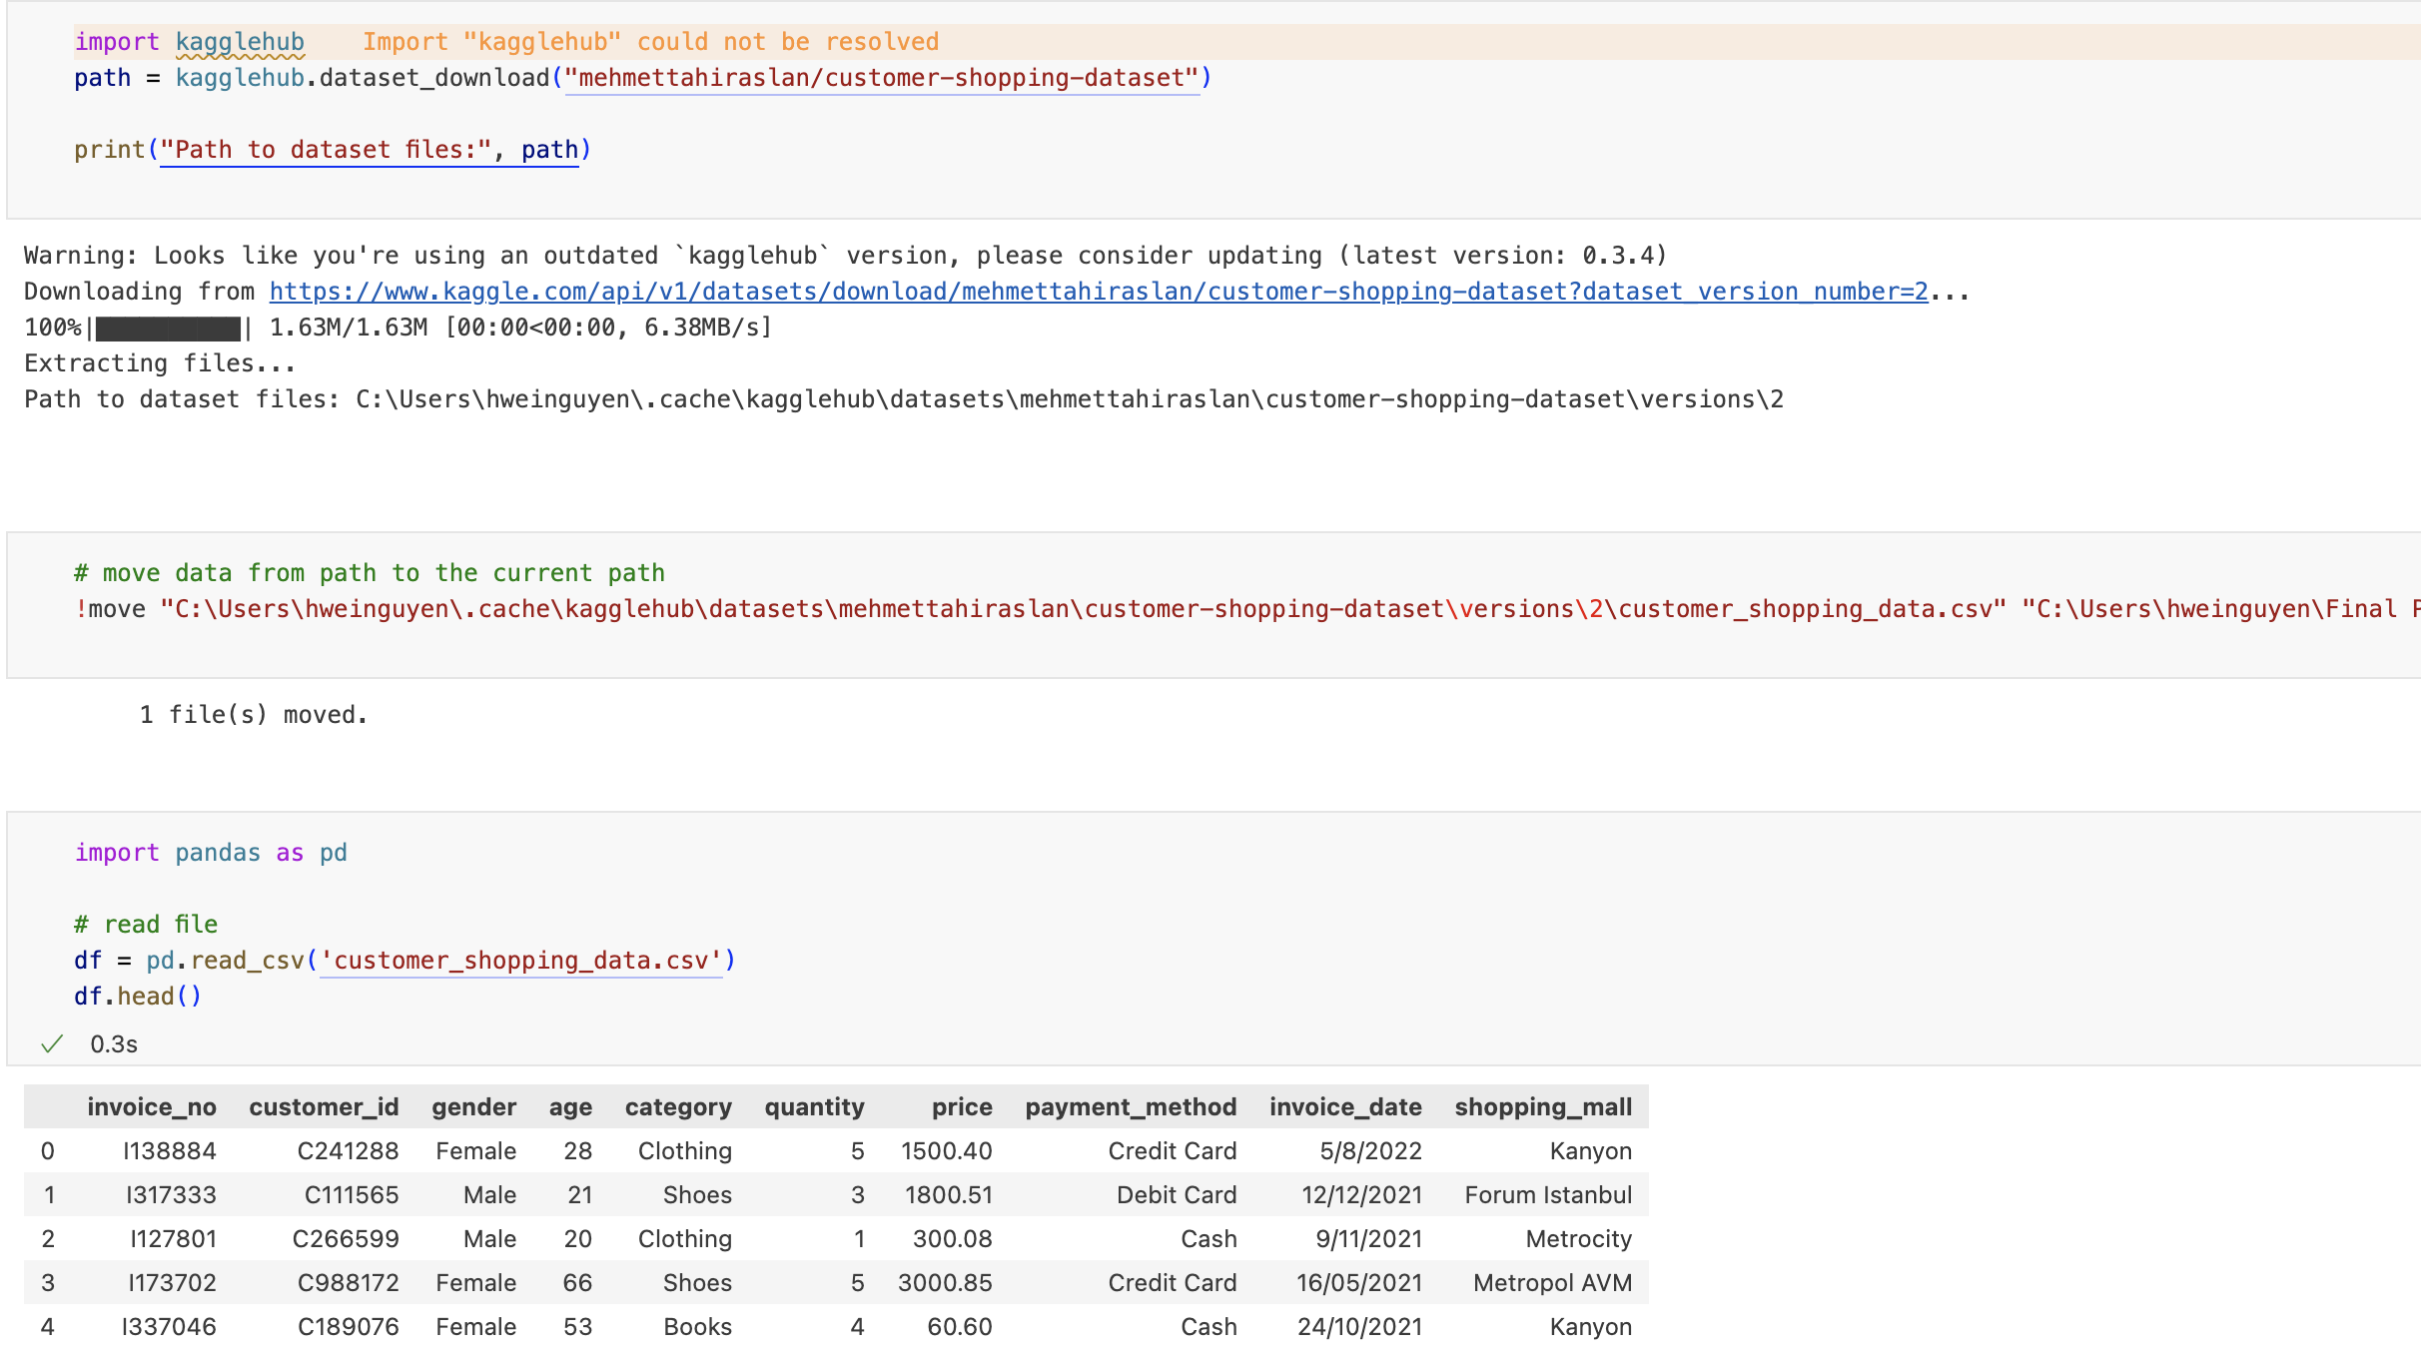
Data acquisition

Slide 13
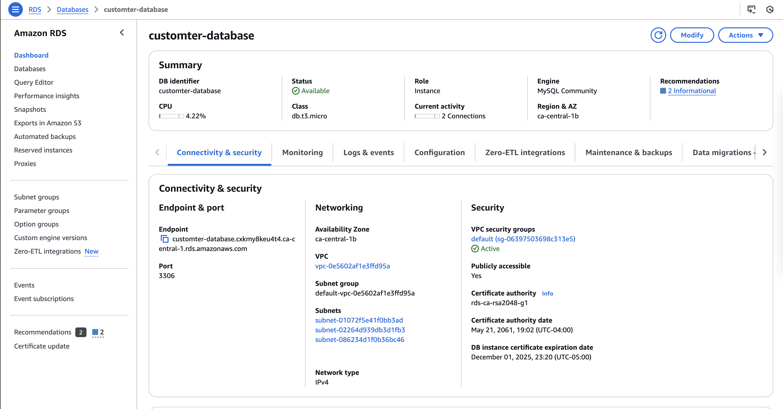
Storage

Slide 14
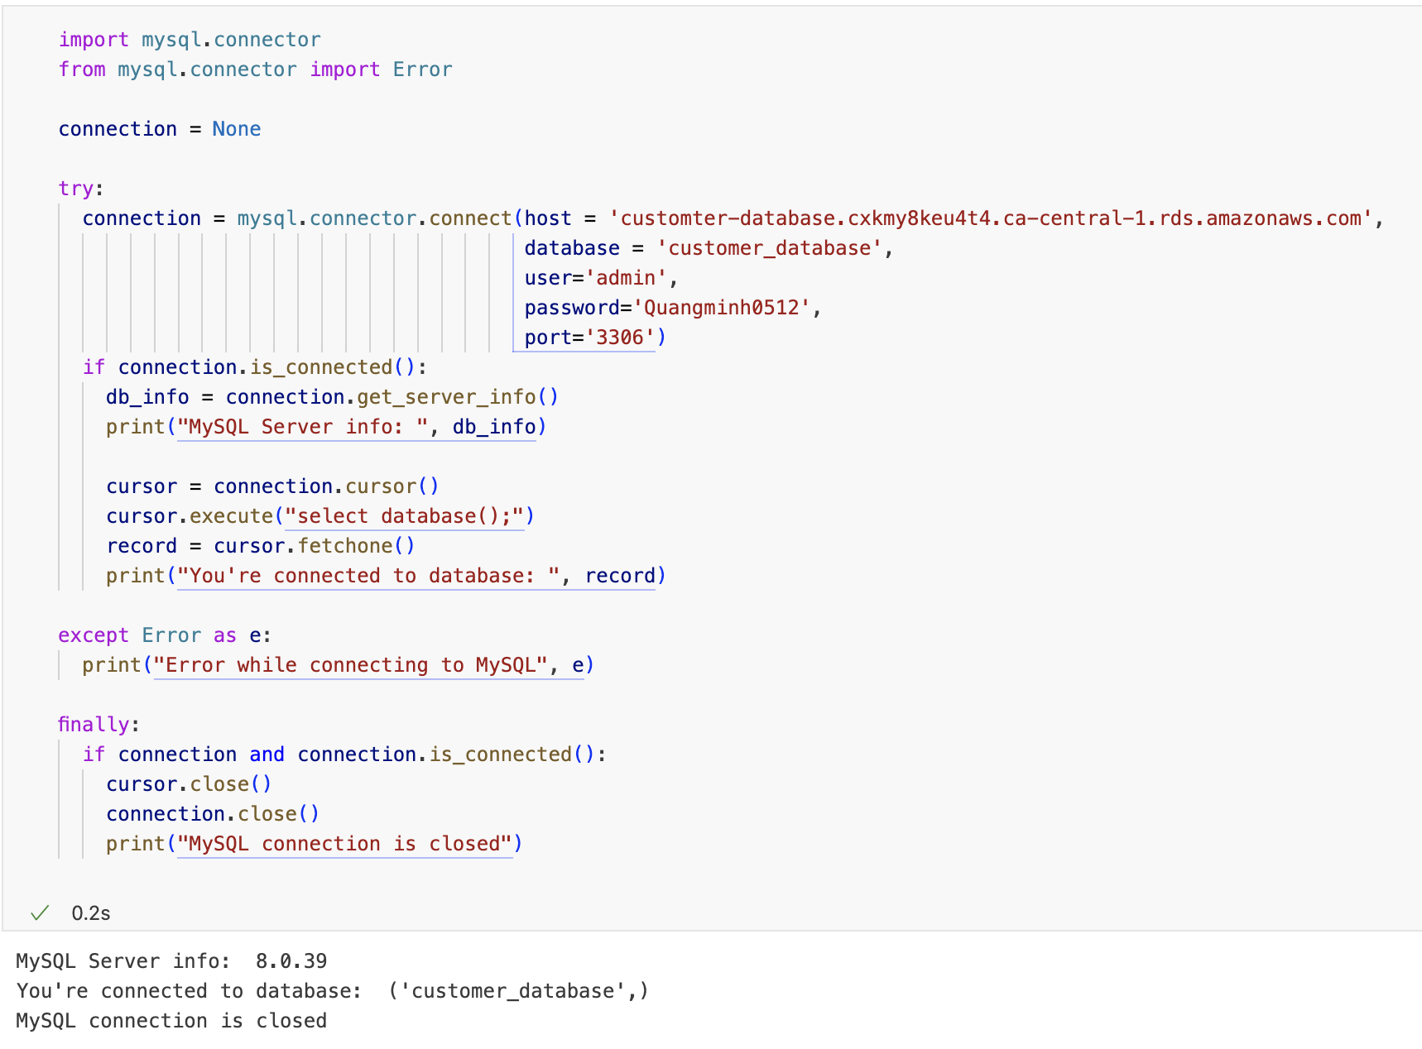
Check connection

Slide 15
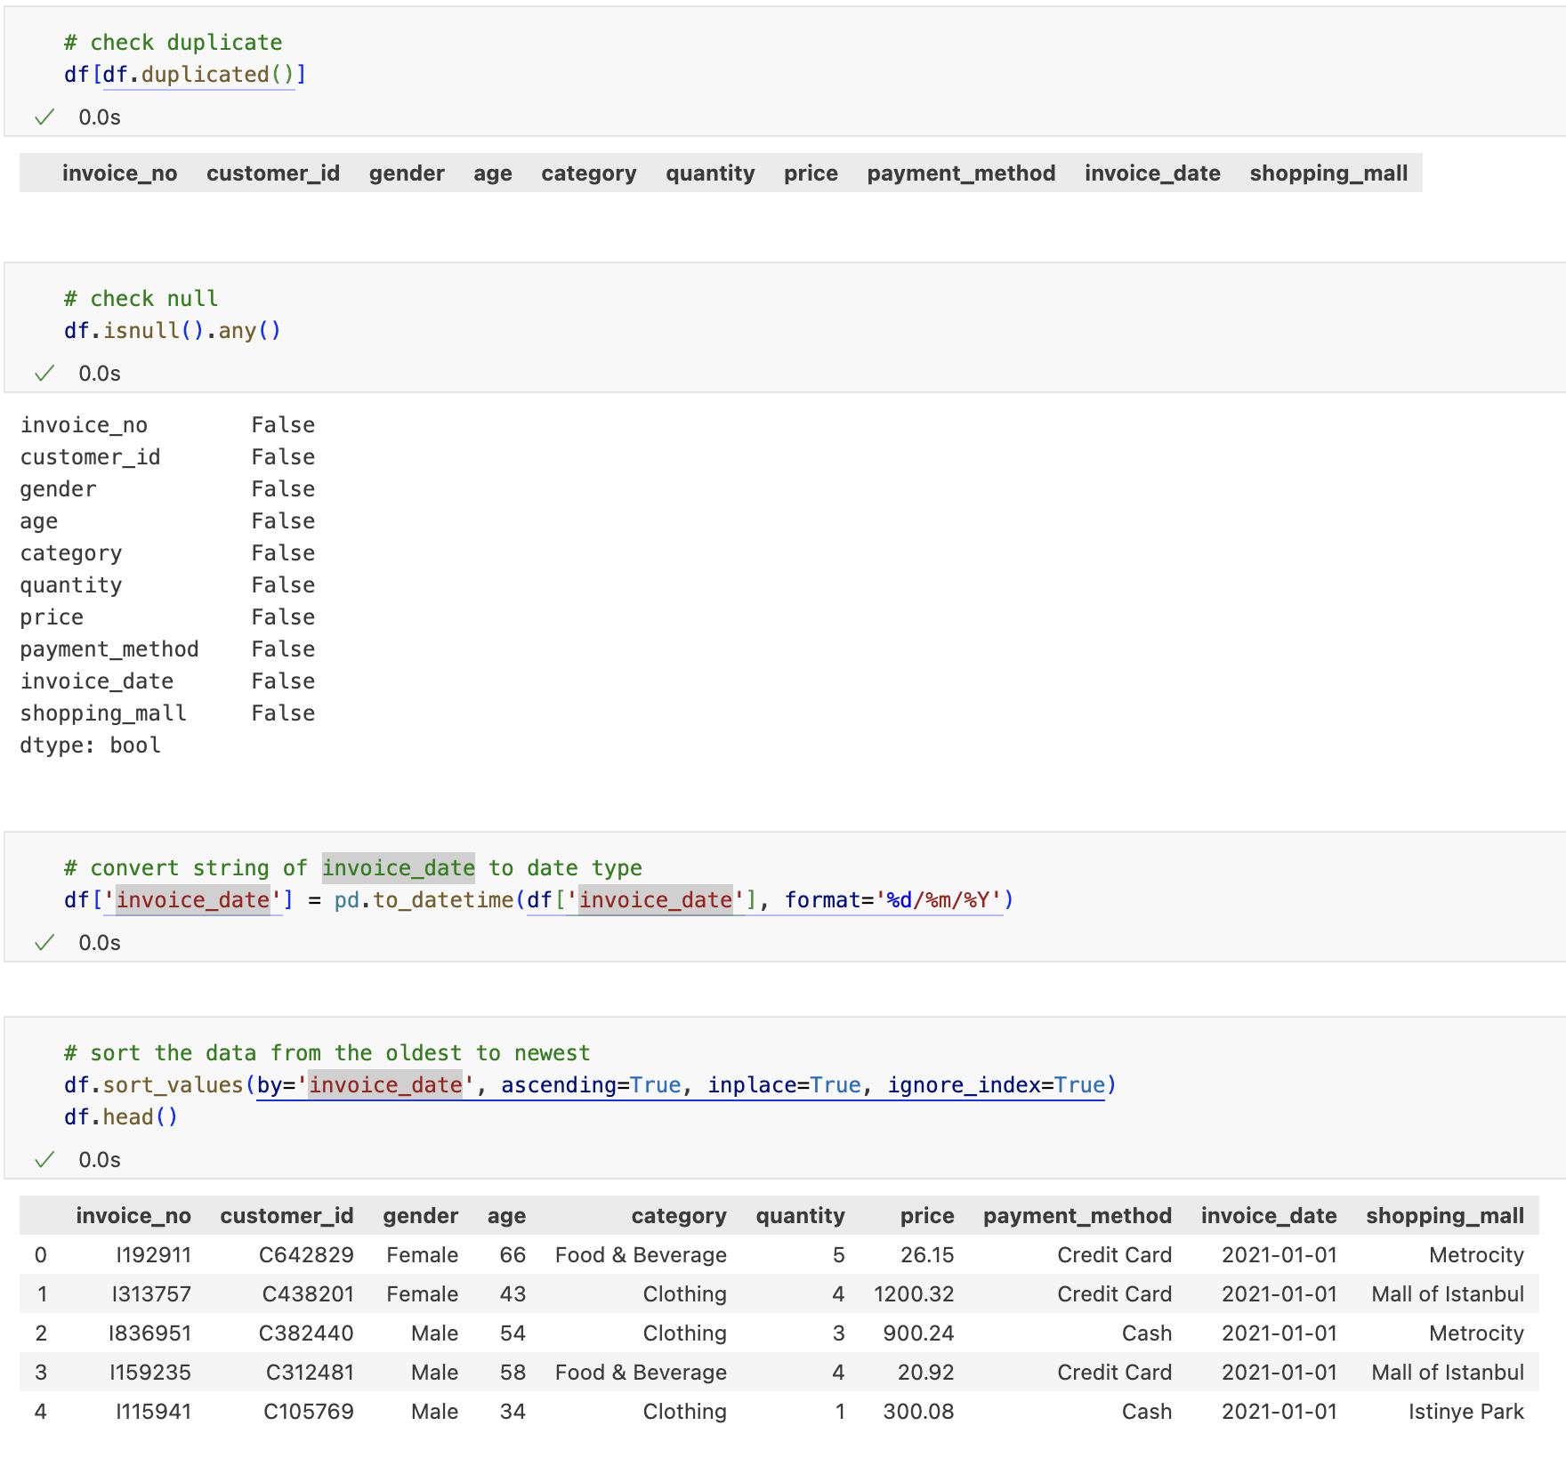
Clean data

Slide 16
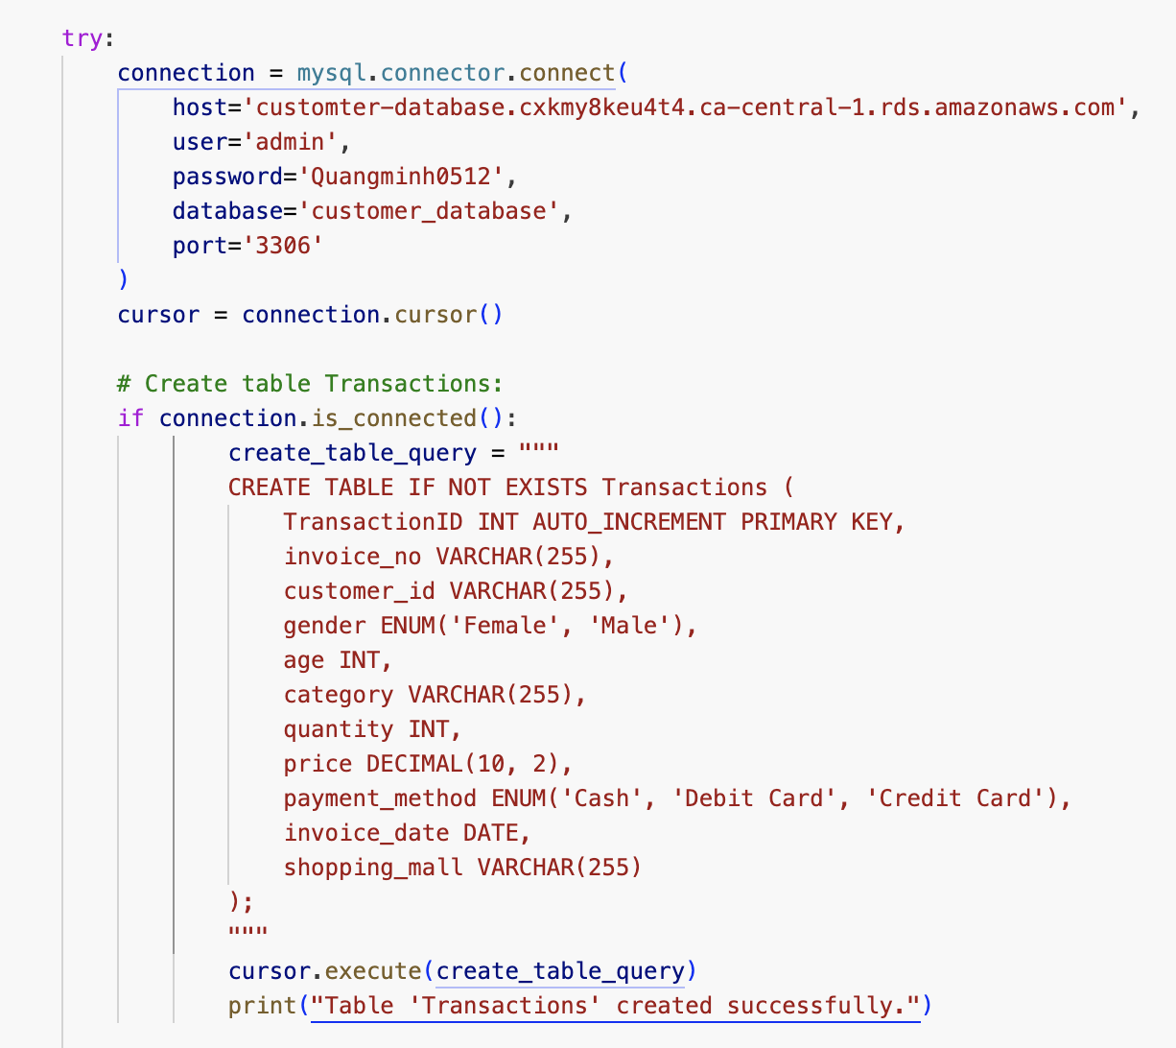
Create table

Slide 17
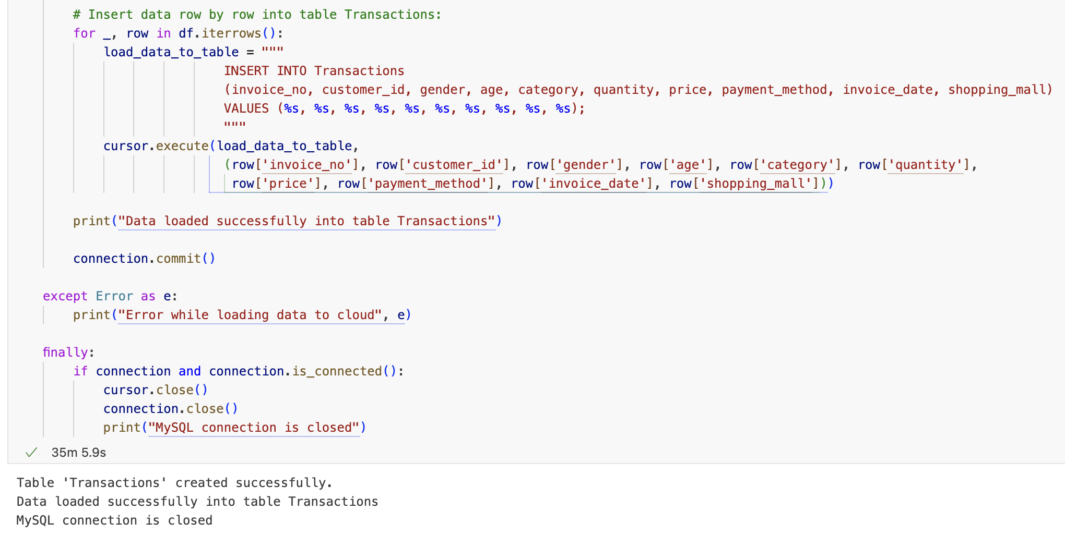
Insert data

Slide 18
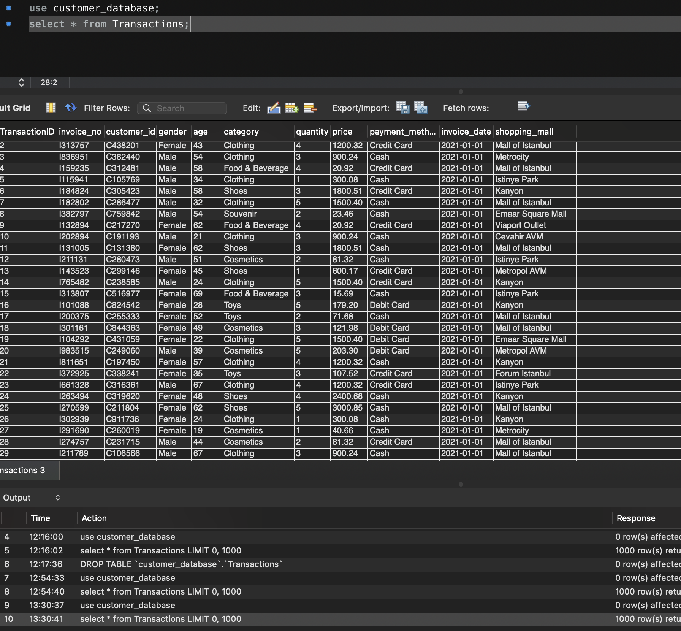
Double check with MySQL workbench

Slide 19


Data Analysis & Visualization

Slide 20
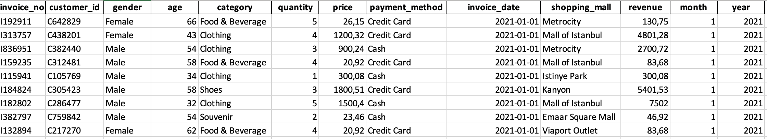
Data cleaning
Handled Missing Values
Standardized Formats
Created New Columns
Added a Revenue column
Extracted Month and Year from Invoice Date

Slide 21
Business Questions:
Which product categories generate the highest revenue across different shopping malls?
01
What are the shopping patterns across gender groups?
02
How does revenue fluctuate overtime (monthly/yearly trends)?
03

Slide 22
Exploratory Data Analysis
Revenue Distribution
Category Performance
Customer Demographics
Time-Series Analysis

Slide 23
Question 1: Which product categories generate the highest revenue across shopping malls?

Slide 24
Question 2: What are the shopping patterns across gender group?

Slide 25
Question 3: How does revenue fluctuate over time?

Slide 26
Strategic Business Recommendations
Focus on Top Categories
Optimize Seasonal Campaigns
Cater to Diverse Demographics

Slide 27

Conclusion
Insights into customer demographics, shopping patterns, and revenue trends
Guide strategic decisions
Drive growth and improve customer loyalty effectively

Slide 28
Thank you

